Slide 1
Machine learning 101 Logistic regression and gradient descent
Han Xiao
hxiao29@wisc.edu
CEE department

Slide 2
Objective
Linear supervised method
Apply logistic regression to binary classification
Understand Gradient Descent

Slide 3
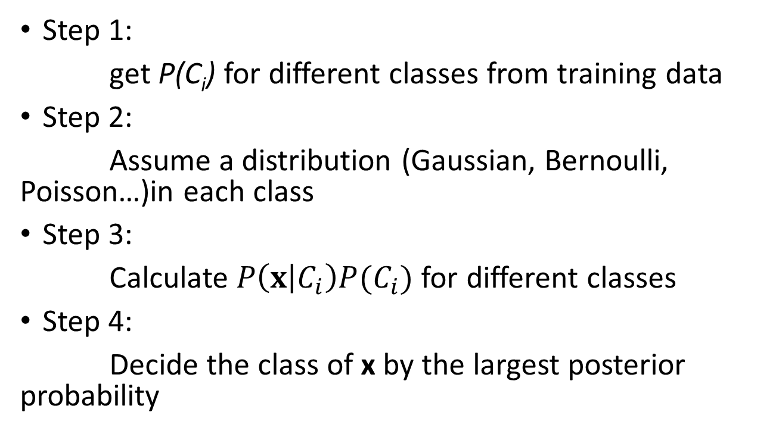
Bayes method
Step 1:
get P(C_{i}) for different classes from training data
Step 2:
Assume a distribution (Gaussian, Bernoulli, Poisson…)in each class
Step 3:
Calculate $P\left(x | C_{i}\right)P(C_{i})$for different classes
Step 4:
Decide the class of x by the largest posterior probability

Slide 4
Bayes method
MATH ALERT!

Slide 5
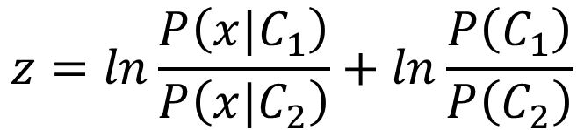

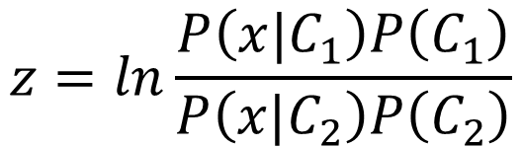
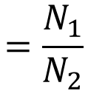

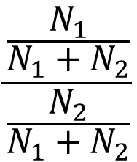
Posterior Probability
$$z=ln\frac{P\left(x|C_{1}\right)P\left(C_{1}\right)}{P\left(x|C_{2}\right)P\left(C_{2}\right)}$$
$$P\left(C_{1}|x\right)$$
$$=σ\left(z\right)$$
sigmoid
$$\frac{\frac{N_{1}}{N_{1}+N_{2}}}{\frac{N_{2}}{N_{1}+N_{2}}}$$
$$z=ln\frac{P\left(x|C_{1}\right)}{P\left(x|C_{2}\right)}+ln\frac{P\left(C_{1}\right)}{P\left(C_{2}\right)}$$
$$=\frac{N_{1}}{N_{2}}$$
$$P\left(x|C_{1}\right)=\frac{1}{{\left(2π\right)}^{D/2}}\frac{1}{{\left|Σ^{1}\right|}^{1/2}}exp\left\{−\frac{1}{2}{\left(x−μ^{1}\right)}^{T}{\left(Σ^{1}\right)}^{−1}\left(x−μ^{1}\right)\right\}$$
$$P\left(x|C_{2}\right)=\frac{1}{{\left(2π\right)}^{D/2}}\frac{1}{{\left|Σ^{2}\right|}^{1/2}}exp\left\{−\frac{1}{2}{\left(x−μ^{2}\right)}^{T}{\left(Σ^{2}\right)}^{−1}\left(x−μ^{2}\right)\right\}$$

Slide 6

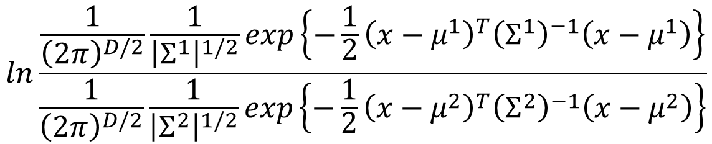
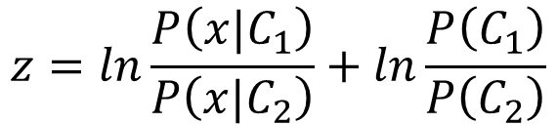
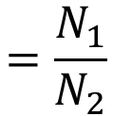
$$z=ln\frac{P\left(x|C_{1}\right)}{P\left(x|C_{2}\right)}+ln\frac{P\left(C_{1}\right)}{P\left(C_{2}\right)}$$
$$=\frac{N_{1}}{N_{2}}$$
$$P\left(x|C_{1}\right)=\frac{1}{{\left(2π\right)}^{D/2}}\frac{1}{{\left|Σ^{1}\right|}^{1/2}}exp\left\{−\frac{1}{2}{\left(x−μ^{1}\right)}^{T}{\left(Σ^{1}\right)}^{−1}\left(x−μ^{1}\right)\right\}$$
$$P\left(x|C_{2}\right)=\frac{1}{{\left(2π\right)}^{D/2}}\frac{1}{{\left|Σ^{2}\right|}^{1/2}}exp\left\{−\frac{1}{2}{\left(x−μ^{2}\right)}^{T}{\left(Σ^{2}\right)}^{−1}\left(x−μ^{2}\right)\right\}$$
$$ln\frac{\frac{1}{{\left(2π\right)}^{D/2}}\frac{1}{{\left|Σ^{1}\right|}^{1/2}}exp\left\{−\frac{1}{2}{\left(x−μ^{1}\right)}^{T}{\left(Σ^{1}\right)}^{−1}\left(x−μ^{1}\right)\right\}}{\frac{1}{{\left(2π\right)}^{D/2}}\frac{1}{{\left|Σ^{2}\right|}^{1/2}}exp\left\{−\frac{1}{2}{\left(x−μ^{2}\right)}^{T}{\left(Σ^{2}\right)}^{−1}\left(x−μ^{2}\right)\right\}}$$
$$=ln\frac{{\left|Σ^{2}\right|}^{1/2}}{{\left|Σ^{1}\right|}^{1/2}}exp\left\{−\frac{1}{2}\left[{\left(x−μ^{1}\right)}^{T}{\left(Σ^{1}\right)}^{−1}\left(x−μ^{1}\right)−{\left(x−μ^{2}\right)}^{T}{\left(Σ^{2}\right)}^{−1}\left(x−μ^{2}\right)\right]\right\}$$
$$=ln\frac{{\left|Σ^{2}\right|}^{1/2}}{{\left|Σ^{1}\right|}^{1/2}}−\frac{1}{2}\left[{\left(x−μ^{1}\right)}^{T}{\left(Σ^{1}\right)}^{−1}\left(x−μ^{1}\right)−{\left(x−μ^{2}\right)}^{T}{\left(Σ^{2}\right)}^{−1}\left(x−μ^{2}\right)\right]$$

Slide 7


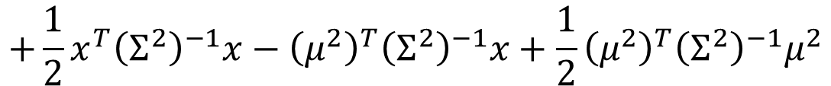

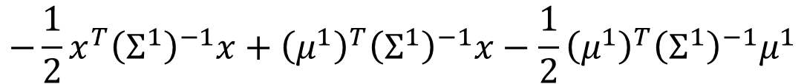

$$z=ln\frac{P\left(x|C_{1}\right)}{P\left(x|C_{2}\right)}+ln\frac{P\left(C_{1}\right)}{P\left(C_{2}\right)}$$
$$=\frac{N_{1}}{N_{2}}$$
$$=ln\frac{{\left|Σ^{2}\right|}^{1/2}}{{\left|Σ^{1}\right|}^{1/2}}−\frac{1}{2}\left[{\left(x−μ^{1}\right)}^{T}{\left(Σ^{1}\right)}^{−1}\left(x−μ^{1}\right)−{\left(x−μ^{2}\right)}^{T}{\left(Σ^{2}\right)}^{−1}\left(x−μ^{2}\right)\right]$$
$${\left(x−μ^{1}\right)}^{T}{\left(Σ^{1}\right)}^{−1}\left(x−μ^{1}\right)$$
$=x^{T}{\left(Σ^{1}\right)}^{−1}x−x^{T}{\left(Σ^{1}\right)}^{−1}μ^{1}−{\left(μ^{1}\right)}^{T}{\left(Σ^{1}\right)}^{−1}x$ $+{\left(μ^{1}\right)}^{T}{\left(Σ^{1}\right)}^{−1}μ^{1}$
$$=x^{T}{\left(Σ^{1}\right)}^{−1}x−2{\left(μ^{1}\right)}^{T}{\left(Σ^{1}\right)}^{−1}x+{\left(μ^{1}\right)}^{T}{\left(Σ^{1}\right)}^{−1}μ^{1}$$
$${\left(x−μ^{2}\right)}^{T}{\left(Σ^{2}\right)}^{−1}\left(x−μ^{2}\right)$$
$$=x^{T}{\left(Σ^{2}\right)}^{−1}x−2{\left(μ^{2}\right)}^{T}{\left(Σ^{2}\right)}^{−1}x+{\left(μ^{2}\right)}^{T}{\left(Σ^{2}\right)}^{−1}μ^{2}$$
$$z=ln\frac{{\left|Σ^{2}\right|}^{1/2}}{{\left|Σ^{1}\right|}^{1/2}}$$
$$−\frac{1}{2}x^{T}{\left(Σ^{1}\right)}^{−1}x+{\left(μ^{1}\right)}^{T}{\left(Σ^{1}\right)}^{−1}x−\frac{1}{2}{\left(μ^{1}\right)}^{T}{\left(Σ^{1}\right)}^{−1}μ^{1}$$
$$+\frac{1}{2}x^{T}{\left(Σ^{2}\right)}^{−1}x−{\left(μ^{2}\right)}^{T}{\left(Σ^{2}\right)}^{−1}x+\frac{1}{2}{\left(μ^{2}\right)}^{T}{\left(Σ^{2}\right)}^{−1}μ^{2}$$
$$+ln\frac{N_{1}}{N_{2}}$$

Slide 8
End of Warning

Slide 9






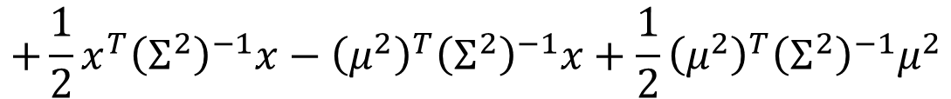
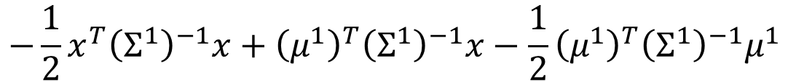


$$P\left(C_{1}|x\right)$$
$$=σ\left(z\right)$$
$$z=ln\frac{{\left|Σ^{2}\right|}^{1/2}}{{\left|Σ^{1}\right|}^{1/2}}$$
$$−\frac{1}{2}x^{T}{\left(Σ^{1}\right)}^{−1}x+{\left(μ^{1}\right)}^{T}{\left(Σ^{1}\right)}^{−1}x−\frac{1}{2}{\left(μ^{1}\right)}^{T}{\left(Σ^{1}\right)}^{−1}μ^{1}$$
$$+\frac{1}{2}x^{T}{\left(Σ^{2}\right)}^{−1}x−{\left(μ^{2}\right)}^{T}{\left(Σ^{2}\right)}^{−1}x+\frac{1}{2}{\left(μ^{2}\right)}^{T}{\left(Σ^{2}\right)}^{−1}μ^{2}$$
$$+ln\frac{N_{1}}{N_{2}}$$
$$Σ_{1}=Σ_{2}=Σ$$
$$z={\left(μ^{1}−μ^{2}\right)}^{T}Σ^{−1}x−\frac{1}{2}{\left(μ^{1}\right)}^{T}Σ^{−1}μ^{1}+\frac{1}{2}{\left(μ^{2}\right)}^{T}Σ^{−1}μ^{2}+ln\frac{N_{1}}{N_{2}}$$
$$w^{T}$$
$$b$$
$$P\left(C_{1}|x\right)=σ\left(w∙x+b\right)$$
How about directly find w and b?
In generative model, we estimate $N_{1},$ $N_{2}$, $μ^{1}$, $μ^{2}$, $Σ$
Then we have w and b

Slide 10
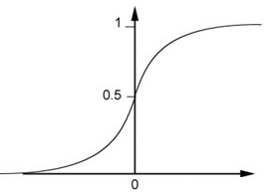

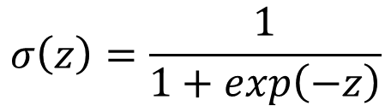
Logistic regression
Calculate probabilities of a class C_{i} given x using sigmoid function
Output of logistic regression
between 0 - 1
$$P\left(C_{i}|x\right)=σ\left(wx+b\right)$$
$$σ\left(z\right)=\frac{1}{1+exp\left(−z\right)}$$

Slide 11
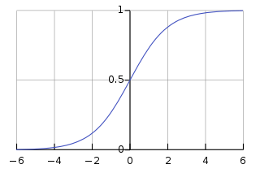
Logistic regression
Use sigmoid function as an assumption of posterior probability

Slide 12
Logistic regression
How to optimize w ?
Supervised learning: have labels of each x_{n}
Use 1 or 0 as y_{n} (different from what we used before)

Slide 13



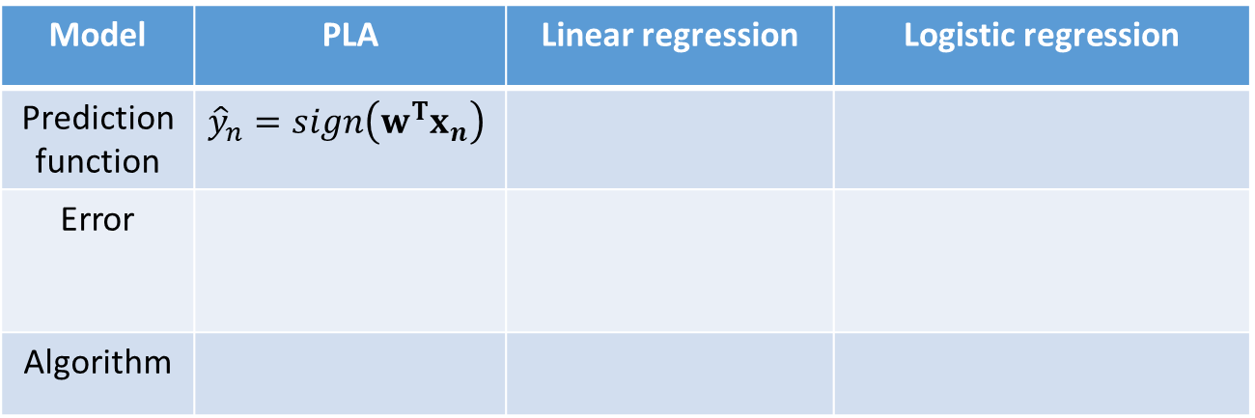



Logistic regression
Model | PLA | Linear regression | Logistic regression
Prediction function | $${\hat{y}}_{n}=sign\left(w^{T}x_{n}\right)$$
Error
Algorithm
$${\hat{y}}_{n}=w^{T}x_{n}$$
$${\hat{y}}_{n}=σ\left(wx+b\right)$$
$$\sum_{i=1}^{n}{⟦{\hat{y}}_{i}≠y_{i}⟧}$$
$$\frac{1}{N}\sum_{i=1}^{N}{(}{y_{i}−{\hat{y}}_{i})}^{2}$$
???
$$w_{t+1}←w_{t}+y_{n}x_{n}$$
$$w=X^{+}Y$$
???

Slide 14










Logistic regression
What we want : probabilities for each given x $P\left(C_{i}|x\right)$
Maximum likelihood!
Training
Data
$$x^{1}$$
$$x^{2}$$
$$x^{3}$$
$$x^{N}$$
$$……$$
$$C_{1}$$
$$C_{1}$$
$$C_{2}$$
$$C_{1}$$
${}_{w,b}^{max}{P\left(x_{1} | C_{1}\right)}$ $P\left(x_{2} | C_{1}\right)$ $P\left(x_{3} | C_{2}\right)…P\left(x_{n} | C_{1}\right)$

Slide 15







Logistic regression
${}_{w,b}^{max}{P\left(x_{1} | C_{1}\right)}$ $P\left(x_{2} | C_{1}\right)$ $P\left(x_{3} | C_{2}\right)…P\left(x_{n} | C_{1}\right)$
Model | PLA | Linear regression | Logistic regression
Prediction function | $${\hat{y}}_{n}=sign\left(w^{T}x_{n}\right)$$
Error
Algorithm
$${\hat{y}}_{n}=w^{T}x_{n}$$
$${\hat{y}}_{n}=σ\left(wx+b\right)$$
$$\sum_{i=1}^{n}{⟦{\hat{y}}_{i}≠y_{i}⟧}$$
$$\frac{1}{N}\sum_{i=1}^{N}{(}{y_{i}−{\hat{y}}_{i})}^{2}$$
???
$$w_{t+1}←w_{t}+y_{n}x_{n}$$
$$w=X^{+}Y$$
???
How could we change the maximum likelihood function similar with other error functions?

Slide 16
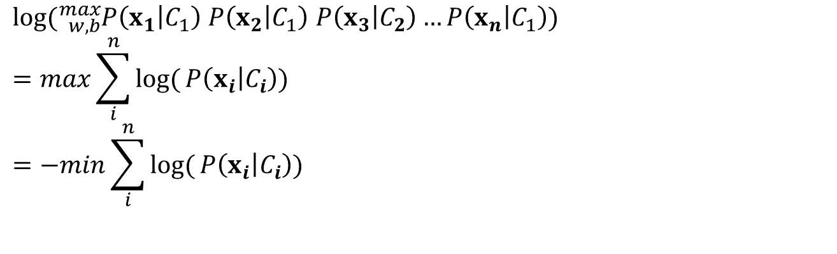
Logistic regression
Change it to sum of all data points:
${}_{w,b}^{max}{P\left(x_{1} | C_{1}\right)}$ $P\left(x_{2} | C_{1}\right)$ $P\left(x_{3} | C_{2}\right)…P\left(x_{n} | C_{1}\right)$
$log⁡({}_{w,b}^{max}{P\left(x_{1} | C_{1}\right)}$ $P\left(x_{2} | C_{1}\right)$ $P\left(x_{3} | C_{2}\right)…P\left(x_{n} | C_{1}\right))$
$$=max\sum_{i}^{n}{log⁡(}P\left(x_{i} | C_{i}\right))$$
$$=−min\sum_{i}^{n}{log⁡(}P\left(x_{i} | C_{i}\right))$$

Slide 17

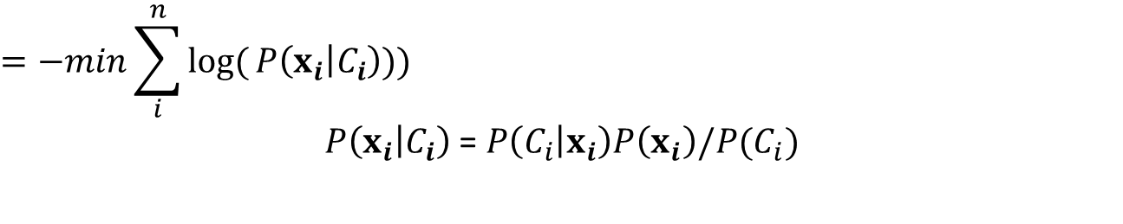
Logistic regression
$$=−min\sum_{i}^{n}{log⁡(}P\left(x_{i} | C_{i}\right)))$$
$P\left(x_{i} | C_{i}\right)$ = $P\left(C_{i} | x_{i}\right)P\left(x_{i}\right)/P(C_{i})$
Sigmoid function
Constant
$$P\left(C_{2} | x_{i}\right)=1−P\left(C_{1} | x_{i}\right)$$
$$Error=−⁡[log⁡(σ(wx_{1}+b))+log⁡(σ(wx_{2}+b))+log⁡(1−σ(wx_{3}+b))+…$$

Slide 18


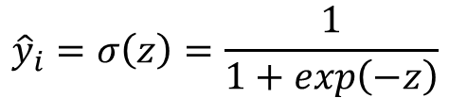
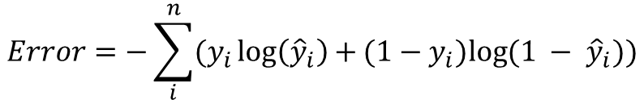
Logistic regression
$$Error=−⁡[log⁡(σ(wx_{1}+b))+log⁡(σ(wx_{2}+b))+log⁡(1−σ(wx_{3}+b))+…$$
$${\hat{y}}_{i}=σ\left(z\right)=\frac{1}{1+exp\left(−z\right)}$$
If x_{i} → C₁ , y_{i} = 1
$$Error=−⁡y_{i}log⁡({\hat{y}}_{i})$$
If x_{i} → C₂ , y_{i} = 0
$$Error=−⁡{(1−y}_{i})log⁡({1 − \hat{y}}_{i})$$
$$Error=−\sum_{i}^{n}{(y_{i}\log\left({\hat{y}}_{i}\right)+}{(1−y}_{i})log⁡({1 − \hat{y}}_{i}))$$
Cross-entropy

Slide 19



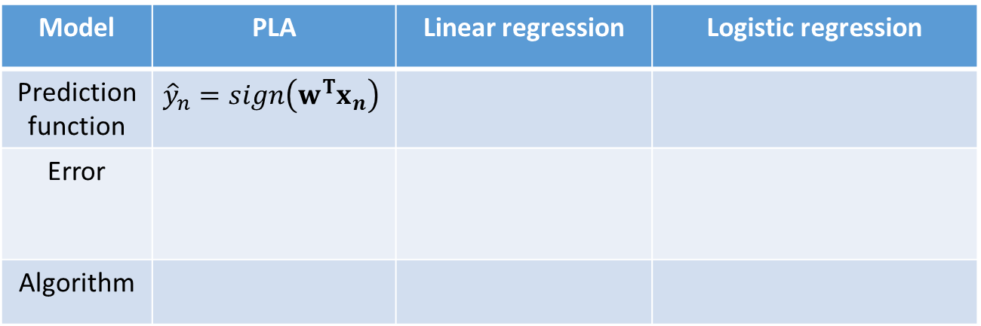



Logistic regression
Model | PLA | Linear regression | Logistic regression
Prediction function | $${\hat{y}}_{n}=sign\left(w^{T}x_{n}\right)$$
Error
Algorithm
$${\hat{y}}_{n}=w^{T}x_{n}$$
$${\hat{y}}_{n}=σ\left(wx+b\right)$$
$$\sum_{i=1}^{n}{⟦{\hat{y}}_{i}≠y_{i}⟧}$$
$$\frac{1}{N}\sum_{i=1}^{N}{(}{y_{i}−{\hat{y}}_{i})}^{2}$$
Maximum likelihood
$$w_{t+1}←w_{t}+y_{n}x_{n}$$
$$w=X^{+}Y$$
GD
???

Slide 20

Gradient descent
Step by step optimization method
In PLA:
Can we have similar strategy?
$$w_{t+1}←w_{t}+y_{n}x_{n}$$
constant
Correction direction

Slide 21
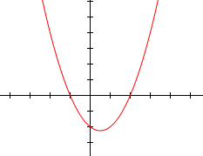
Gradient descent
Error
w, b
How to calculate x with minimum? x = –b/2a
Use step by step optimization

Slide 22

Gradient descent
Step by step optimization method
In PLA:
In GD:
$$w_{t+1}←w_{t}+y_{n}x_{n}$$
constant
Correction direction
$$w_{t+1}←w_{t}+η{\left.\frac{∂E}{∂w}\right|}_{w_{t}}$$
Learning rate

Slide 23


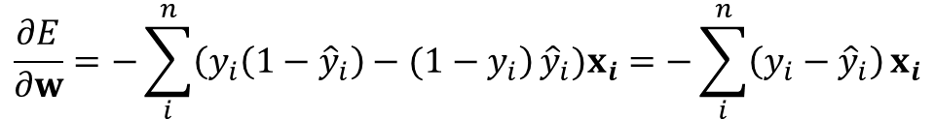
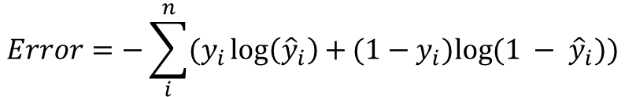


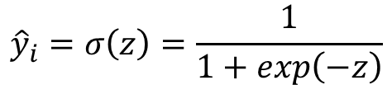


Gradient descent
Calculate gradients in logistic regression
$$Error=−\sum_{i}^{n}{(y_{i}\log\left({\hat{y}}_{i}\right)+}{(1−y}_{i})log⁡({1 − \hat{y}}_{i}))$$
$${\hat{y}}_{i}=σ\left(z\right)=\frac{1}{1+exp\left(−z\right)}$$
$$\frac{∂E}{∂w}=(\frac{∂E}{∂\log\left({\hat{y}}_{i}\right)}\frac{∂\log\left({\hat{y}}_{i}\right)}{∂{\hat{y}}_{i}}+\frac{∂E}{∂\log\left({1−\hat{y}}_{i}\right)}\frac{∂\log\left(1−{\hat{y}}_{i}\right)}{∂{\hat{y}}_{i}})\frac{∂{\hat{y}}_{i}}{∂z}\frac{∂z}{∂w}$$
$$y_{i}$$
$$1/{\hat{y}}_{i}$$
$${1−y}_{i}$$
$$−1/{(1−\hat{y}}_{i})$$
$${\hat{y}}_{i} {(1−\hat{y}}_{i})$$
$$x_{i}$$
$$\frac{∂E}{∂w}=−\sum_{i}^{n}{\left(y_{i}\left(1−{\hat{y}}_{i}\right)−{(1−y}_{i}\right)}{\hat{y}}_{i})x_{i}=−\sum_{i}^{n}{\left(y_{i}−{\hat{y}}_{i}\right)}x_{i}$$

Slide 24



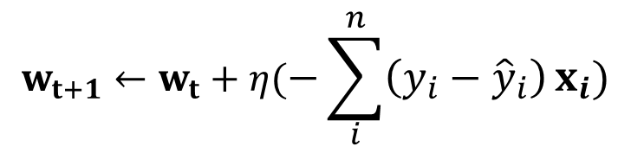




Gradient descent
Updating algorithm:
$$w_{t+1}←w_{t}+η(−\sum_{i}^{n}{\left(y_{i}−{\hat{y}}_{i}\right)}x_{i})$$
Model | PLA | Linear regression | Logistic regression
Prediction function | $${\hat{y}}_{n}=sign\left(w^{T}x_{n}\right)$$
Error
Algorithm
$${\hat{y}}_{n}=w^{T}x_{n}$$
$${\hat{y}}_{n}=σ\left(wx+b\right)$$
$$\sum_{i=1}^{n}{⟦{\hat{y}}_{i}≠y_{i}⟧}$$
$$\frac{1}{N}\sum_{i=1}^{N}{(}{y_{i}−{\hat{y}}_{i})}^{2}$$
Maximum likelihood
$$w_{t+1}←w_{t}+y_{n}x_{n}$$
$$w=X^{+}Y$$
GD

Slide 25

Logistic regression
Two questions:
How to decide $η$?
How about using an easier error function?

Slide 26


How to decide $η$?
If $η$ too small → slow learning!
If $η$ too large → jump around!

Slide 27


How to decide $η$?
Make it large first, then reduce it gradually depends on the number of iteration
Adam, RMSprop…
$$η_{t}=\frac{η}{1+t}$$
$$η_{t}=\frac{η}{\sqrt{1+t}}$$

Slide 28







How about using an easier error function?
Use the one for linear regression:
Easier to get gradients!
Model | PLA | Linear regression | Logistic regression
Prediction function | $${\hat{y}}_{n}=sign\left(w^{T}x_{n}\right)$$
Error
Algorithm
$${\hat{y}}_{n}=w^{T}x_{n}$$
$${\hat{y}}_{n}=σ\left(wx+b\right)$$
$$\sum_{i=1}^{n}{⟦{\hat{y}}_{i}≠y_{i}⟧}$$
$$\frac{1}{N}\sum_{i=1}^{N}{(}{y_{i}−{\hat{y}}_{i})}^{2}$$
Maximum likelihood
$$w_{t+1}←w_{t}+y_{n}x_{n}$$
$$w=X^{+}Y$$
GD

Slide 29
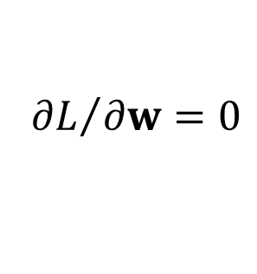
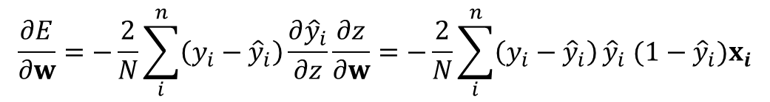

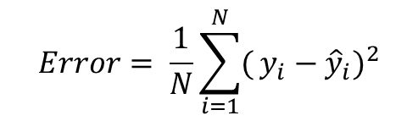
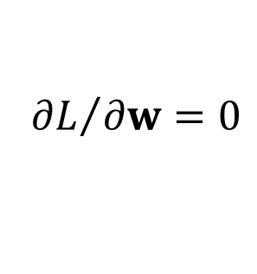


How about using an easier error function?
$$Error= \frac{1}{N}\sum_{i=1}^{N}{(}{y_{i}−{\hat{y}}_{i})}^{2}$$
$$\frac{∂E}{∂w}=−\frac{2}{N}\sum_{i}^{n}{\left(y_{i}−{\hat{y}}_{i}\right)\frac{∂{\hat{y}}_{i}}{∂z}\frac{∂z}{∂w}}={−\frac{2}{N}\sum_{i}^{n}{\left(y_{i}−{\hat{y}}_{i}\right)}\hat{y}}_{i} {(1−\hat{y}}_{i})x_{i}$$
$$y_{i}=0$$
If${ \hat{y}}_{i}=1$
(far from target)
$${∂L}/{∂w}=0$$
If${ \hat{y}}_{i}=0$
(close to target)
$${∂L}/{∂w}=0$$

Slide 30

How about using an easier error function?
Cross Entropy
Total
Loss
Square
Error

Slide 31

Questions?
Topic of next lecture: Neural network

